Slide 1
GRADIENT DESCENT
Bakul Gohel, Ph.D.
DA-IICT, Gandhinagar

Slide 2


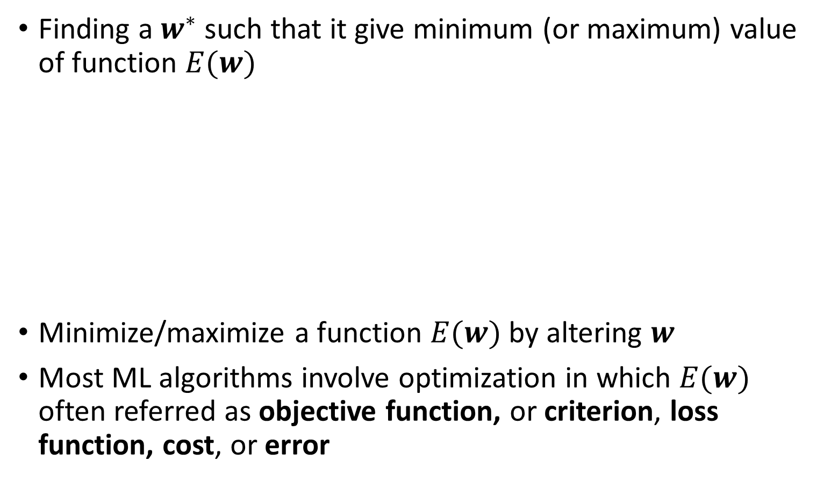



Optimization: Gradient Descent
Finding a $w^{∗}$such that it give minimum (or maximum) value of function $E(w)$
Minimize/maximize a function $E(w)$ by altering $w$
Most ML algorithms involve optimization in which $E(w)$ often referred as objective function, or criterion, loss function, cost, or error
$$E(w)$$
$w^{∗}=argmin E(w)$
$$argmin E(w)$$
$$w^{∗}$$
$$w$$

Slide 3







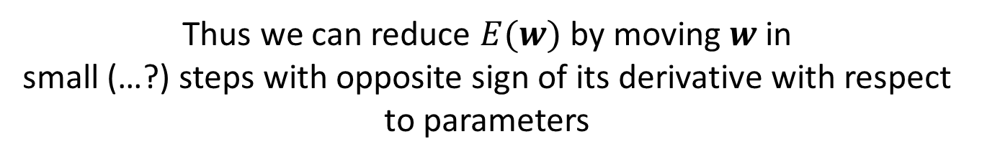





Optimization: Gradient Descent
$$E(w)$$
$$+ve gradient$$
$$−ve gradient$$
$$E^{′}(w^{k})$$
$$argmin E(w)$$
$$E^{′}(w^{k})$$
$${ E}^{′}\left(w^{∗}\right)=0$$
$$w^{∗}$$
$$w$$
$$w^{k}$$
$$w^{k}$$
$$w^{k+1}=w^{k}−η{∙E}^{′}(w^{k})$$
Thus we can reduce $E(w)$ by moving $w$ in
small (…?) steps with opposite sign of its derivative with respect to parameters

Slide 4


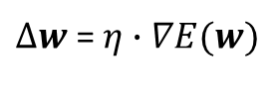


Gradient Descent
$$w^{k+1}=w^{k}−η{∙E}^{′}(w^{k})$$
or
$$w^{k+1}=w^{k}−η∙∇E(w^{k})$$
or
$$w←w−∆w$$
$∆w$ = $η∙∇E(w)$
$w^{∗}=argmin E\left(w\right)$
$$→{ E}^{′}\left(w^{∗}\right)=0$$
$→$ |$w^{k+1}−w^{k}|=0$
converse is not true

Slide 5
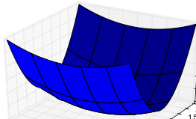




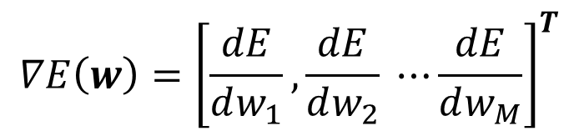
Gradient Descent
Consider, Multivariate function $E:ℝ^{M}→ℝ$
$$w={[w_{1} ,w_{1} ⋯w_{M}]}^{T}$$
$$∇E\left(w\right)={\left[\frac{dE}{dw_{1}},\frac{dE}{dw_{2}} ⋯\frac{dE}{dw_{M}}\right]}^{T}$$
(gradient Direction)
$$w^{k+1}=w^{k}−η∙∇E(w^{k})$$
$w^{∗}=argmin E\left(w\right)$
$$→\left\|{ E}^{′}\left(w\right)\right\|=0$$
$→$ $\left\|w^{k+1}−w^{k}\right\|=0$
converse is not true

Slide 6
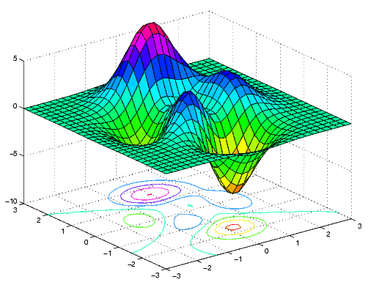
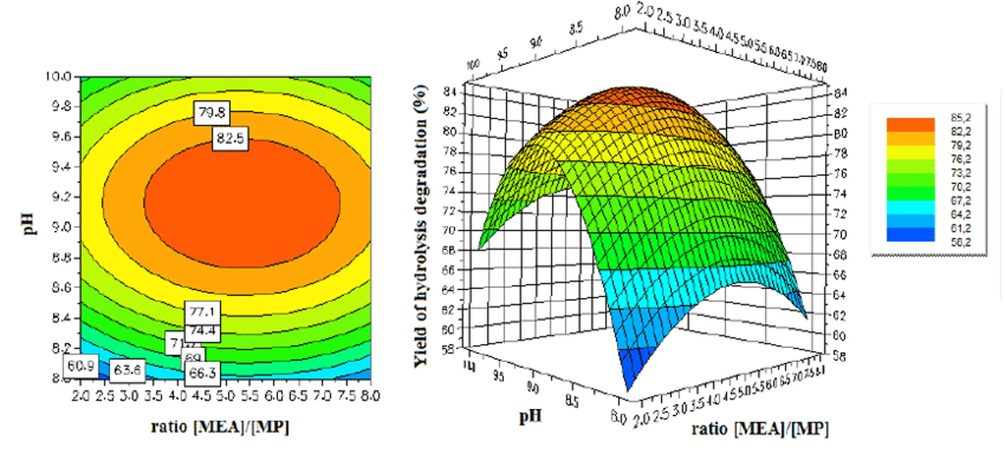










Contour Plot
Consider, Multivariate function $f:ℝ^{2}→ℝ$
$$f(x,y)=z$$
$$z$$
$$y$$
$$x$$
$$y$$
$$z$$
$$x$$
$$y$$
$$x$$

Slide 7
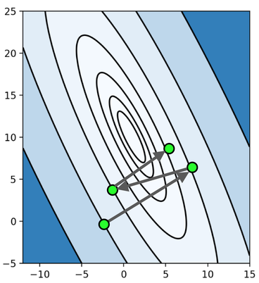

Gradient Descent
Multivariate function $E:ℝ^{M}→ℝ$
gradient vector direction at particular point is
perpendicular to contour curve

Slide 8
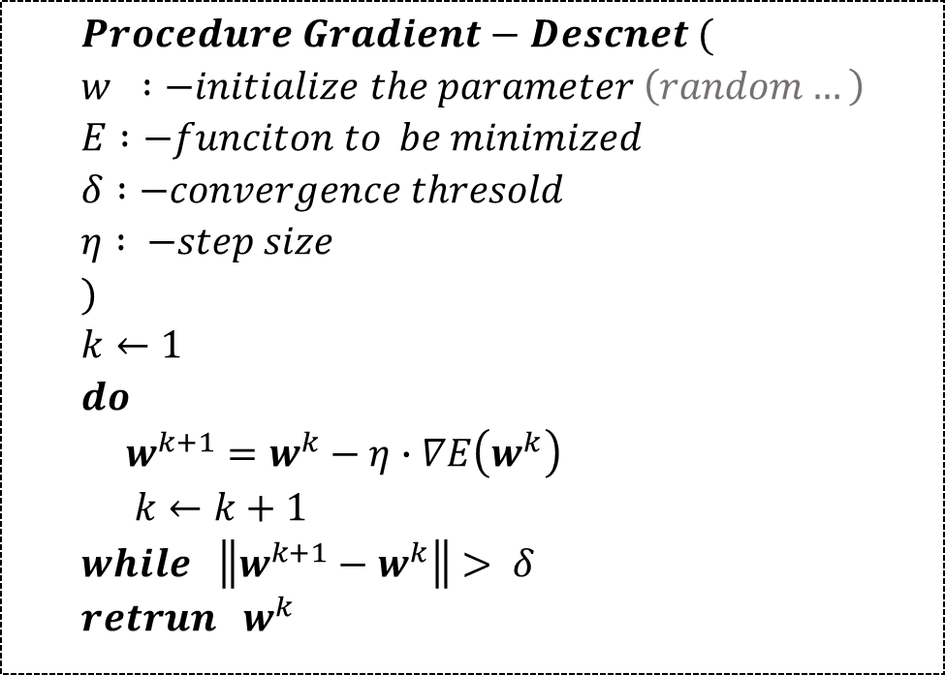
Gradient Descent
$$Procedure Gradient−Descnet ( \\ w :−initialize the parameter \left(random…\right) \\ E :−funciton to be minimized \\ δ :−convergence thresold \\ η : −step size \\ ) \\ k←1 \\ do \\ w^{k+1}=w^{k}−η∙∇E\left(w^{k}\right) \\ k←k+1 \\ while \left\|w^{k+1}−w^{k}\right\|> δ \\ retrun w^{k}$$

Slide 9
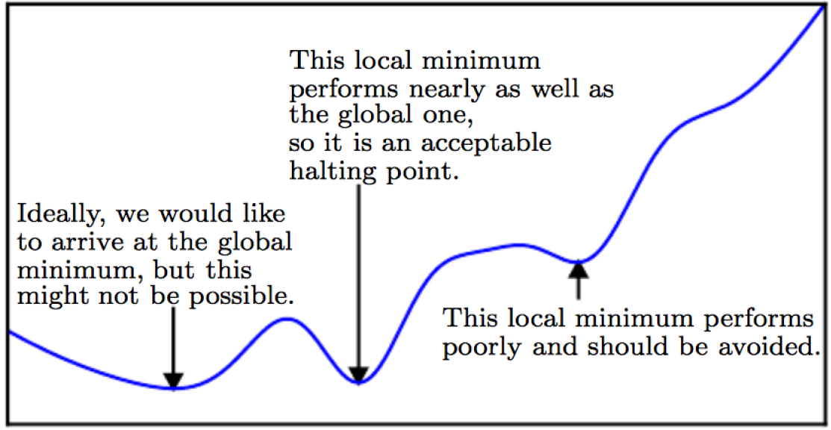


Local vs Global minima
$E(w)$
$$w$$

Slide 10
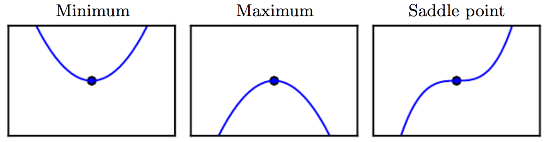
Saddle Point
Saddle Points: neither maxima nor minima but gradient is zero…

Slide 11
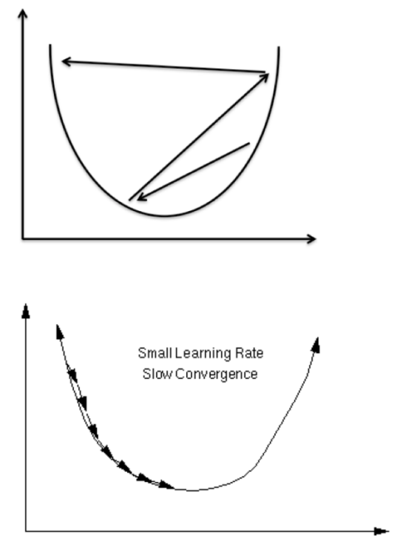

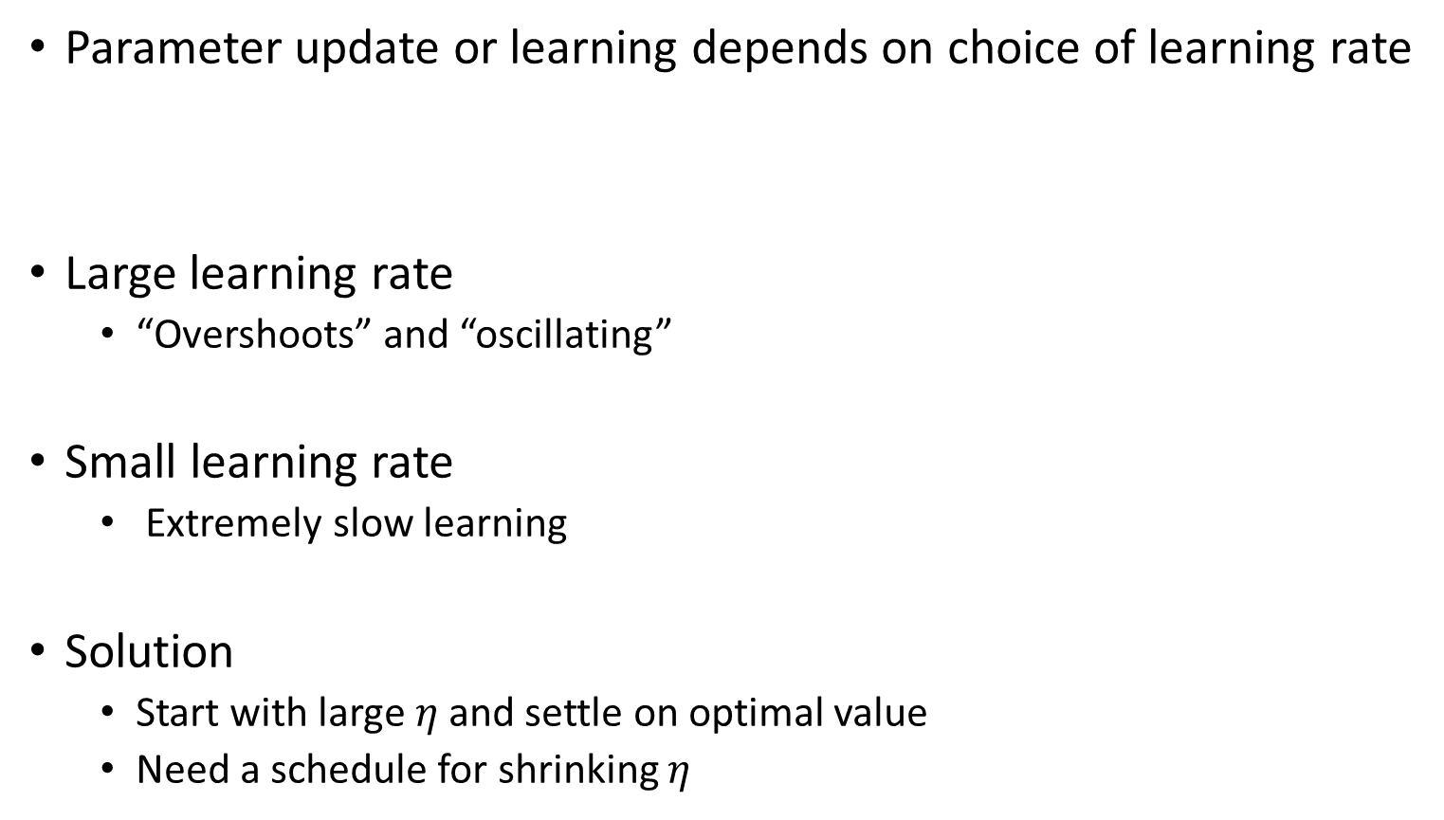
Learning rate or step size
Parameter update or learning depends on choice of learning rate
Large learning rate
“Overshoots” and “oscillating”
Small learning rate
Extremely slow learning
Solution
Start with large $η$ and settle on optimal value
Need a schedule for shrinking $η$
$$w^{k+1}=w^{k}−η∙∇E(w^{k})$$

Slide 12
Gradient Descent in DL
Different variant of Gradient Descent strategies used in ML
Stochastic gradient descent
Momentum
Adagrad
RMSprop
Adam
Etc.
We will learn these algorithm later in a course…

